Slide 1
UNIT - 1

Slide 2
COMPUTER ORGANIZATION & ARCHITECTURE
Computer organization
-Physical aspects of computer systems.
-E.g. circuit design, control signals, memory types.
Computer architecture
-Logical aspects of system as seen by the programmer.
-E.g. instruction seats, instruction formats, data types, addressing modes.
Computer Components
-A processor to interpret and execute programs.
-A memory to store both data and programs.
-A mechanism for transferring data to and from the outside world.

Slide 3
Von Neumann Architecture
The invention of stored program computers has been ascribed to a mathematician, John von Neumann, who was a contemporary of Mauchley and Eckert.
Stored-program computers have become known as von Neumann Architecture systems.

Slide 4
Today’s stored-program computers have the following characteristics:
Three hardware systems:
A central processing unit(CPU)
A main memory system
An I/O system
The capacity to carry out sequential instruction processing.
A single data path between the CPU and main memory.
This single path is known as the von Neumann bottleneck.

Slide 5
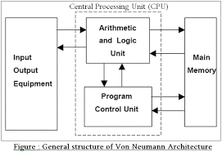
This is general description of a von Neumann systems:

Slide 6
These computers employ a fetch-decode-execute cycle to run programs as follows…
The control unit fetches the next instruction from memory using the program counter to determine where the instruction is located.
The instruction is decoded into a language that the ALU can understand.
Any data operands required to execute the instruction are fetched from memory and placed into registers within the CPU.
The ALU executes the instruction and places results in registers or memory.

Slide 7
Interconnection Structures and Bus Interconnection
Interconnection Structures
A computer consists of a set of components(CPU, memory, I/O) that communicate with each other. The collection of paths connecting the various modules is called interconnection structure. A bus that connects major components(CPU, memory, I/O) is called System Bus.

Slide 8
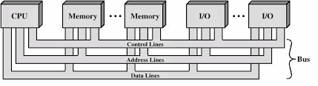
Bus Interconnection and Structure

Slide 9
Bus Structures
A system bus consists of 50-100 lines. Each line is assigned a particular meaning or function. On any bus the lines can be classified into 3 groups :-
Data lines
Address lines
Control lines
Data Lines
- Provide a path for moving data between system modules. These lines, collectively, are called the data bus The data bus typically consists of 8,16 or 32 separate lines, the numbers of lines being transferred to as the width of the data bus. Each line carry only 1 bit at a time, the number of lines determines how many bits can transferred at a time - overall system performance.

Slide 10
The Address Lines
- Used to designate the source or destination of the data on the data bus. The width of the address bus determines the maximum possible memory capacity of the system.
The Control Lines
-Used to control the access to and the use of the data and address lines. Typical control lines include Memory write Memory read I/O write I/O read Clock Reset Bus request Bus grant Interrupt request Interrupt ACK Transfer ACK
Type of transfers
Memory to CPU
CPU to Memory
I/O to CPU
CPU to I/O
I/O to or from Memory (DMA)

Slide 11
Bus Interconnection
- A bus is a communication pathway connecting two or more device. A key characteristic of a bus is that it is a shared transmission medium. A bus consists of multiple pathways or lines. Each line is capable of transmitting signal representing binary digit (1 or 0).
Bus Interconnection
-A sequence of bits can be transmit across a single line. Several lines can be used to transmit bits simultaneously (in parallel). A bus that connects major components (CPU, Memory, I/O) is called System Bus. The most common computer interconnection structures are based on the use of one or more system buses.

Slide 12
UNIT-2

Slide 13
UNIT 2 Input output organization:
Asynchronous data transfer,
strobe control,
handshaking,
PCI, working mechanism of Peripherals:
Keyboard,
Mouse,
Scanners ,
Video Display,
Touch Screen panel etc.(features and principles)

Slide 14
Input output organization:
I/O interface models of transfer,
interrupt driven I/O,
Priority
interrupt,
DMA,
I/O processor and serial communication,
Synchronous data transfer ,

Slide 15
INPUT-OUTPUT ORGANIZATION
The Input / output organization of computer depends upon the size of computer and the peripherals connected to it. The I/O Subsystem of the computer, provides an efficient mode of communication between the central system and the outside environment The most common input output devices are:
i) Monitor
ii) Keyboard
iii) Mouse
iv) Printer
v) Magnetic tapes

Slide 16
Input - Output Interface
Input Output Interface provides a method for transferring information between internal storage and external I/O devices. Peripherals connected to a computer need special communication links for interfacing them with the central processing unit.
I/O BUS and Interface Module It defines the typical link between the processor and several peripherals. The I/O Bus consists of data lines, address lines and control lines. The I/O bus from the processor is attached to all peripherals interface. To communicate with a particular device, the processor places a device address on address lines. Each Interface decodes the address and control received from the I/O bus, interprets them for peripherals and provides signals for the peripheral controller. It is also synchronizes the data flow and supervises the transfer between peripheral and processor. Each peripheral has its own controller. For example, the printer controller controls the paper motion, the print timing The control lines are referred as I/O command. The commands are as following: Control command- A control command is issued to activate the peripheral and to inform it what to do. Status command- A status command is used to test various status conditions in the interface and the peripheral. Data Output command- A data output command causes the interface to respond by transferring data from the bus into one of its registers. Data Input command- The data input command is the opposite of the data output. In this case the interface receives on item of data from the peripheral and places it in its buffer register. I/O Versus Memory Bus

Slide 17
Interrupt driven I/O
Interrupt driven I/O is an alternative scheme dealing with I/O. Interrupt I/O is a way of controlling input/output activity whereby a peripheral or terminal that needs to make or receive a data transfer sends a signal. This will cause a program interrupt to be set. At a time appropriate to the priority level of the I/O interrupt. Relative to the total interrupt system, the processors enter an interrupt service routine. The function of the routine will depend upon the system of interrupt levels and priorities that is implemented in the processor. The interrupt technique requires more complex hardware and software, but makes far more efficient use of the computer’s time and capacities.
For input, the device interrupts the CPU when new data has arrived and is ready to be retrieved by the system processor. The actual actions to perform depend on whether the device uses I/O ports or memory mapping. For output, the device delivers an interrupt either when it is ready to accept new data or to acknowledge a successful data transfer. Memory-mapped and DMA-capable devices usually generate interrupts to tell the system they are done with the buffer
Advantages & Disadvantages of Interrupt Drive I/O
Advantages
- fast
- efficient
Disadvantages
- can be tricky to write if using a low level language
- can be tough to get various pieces to work well together
- usually done by the hardware manufacturer / OS maker, e.g. Microsoft

Slide 18
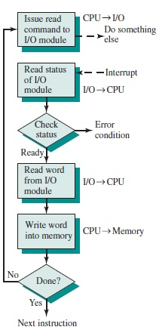
Interrupt Processing

Slide 19
PRIORITY INTERRUPT
In a typical application, a number of I/O devices are attached to computer, with each device being able to originate an interrupt request, so to provide services to device which initiate interrupt request, the task of interrupt system is to identify the source(device) of interrupt and then provide services to them.
But, in most cases there is a possibility that several sources will request service simultaneously.So, in this case, the interrupt system must also need to decide which device to service first.But, these simple interrupt system are not able for that, so, another system known as Priority interrupt system is provided.
Priority Interrupt are systems, that establishes a Priority over the various sources(interrupt devices) to determine which condition is to be serviced first when two or more requests arrive simultaneously.This system may also determine which condition are permitted to interrupt to the computer while another interrupt is being serviced.
Usually, in Priority Systems, higher-priority interrupt levels are served first, as if they delayed or interrupted, could have serious consequences. And the devices with high-speed transfer such as magnetic disks are given high-priority, and slow devices such as keyboards receives low-priority.

Slide 20
Establishing Priority of Simultaneous Interrupt:
The priority of simultaneous interrupts can be established either by software method or hardware.
The software method which gives priority to simultaneous interrupt is:
Polling
And the hardware method which gives priority to simultaneous interrupt is:
Daisy-Chaining Priority
Now, we will explore to each one of them one by one. 1. Polling:
Polling is the software method of establishing priority of simultaneous interrupt.In this method, when the processor detects an interrupt, it branches to an interrupt service routine whose job is to pull each I/O module to determine which module caused the interrupt.
The poll could be in the form of separate command line(e.g., Test I/O).In this case, the processor raises the Test I/O and places the address of particular I/O module on the address line.If it has interrupt that is, if interrupt is identified in it.

Slide 21
And, it is the order in which they are tested i.e., the order in which they appear on address line(Service Routine) determine the priority of each interrupt.As while testing, highest priority source(devices) are tested first then lower-priority devices.
This is very simple method of establishing priority on simultaneous interrupt.But the disadvantage opolling is that it is very time consuming.
2. Daisy-Chaining Priority:
The Daisy–Chaining method of establishing priority on interrupt sources uses the hardware i.e., it is the hardware means of establishing priority.
In this method, all the device, whether they are interrupt sources or not, connected in a serial manner.Means the device with highest priority is placed in the first position, which is followed by lowest priority device.And all device share a common interrupt request line, and the interrupt acknowledge line is daisy chained through the modules.

Slide 22
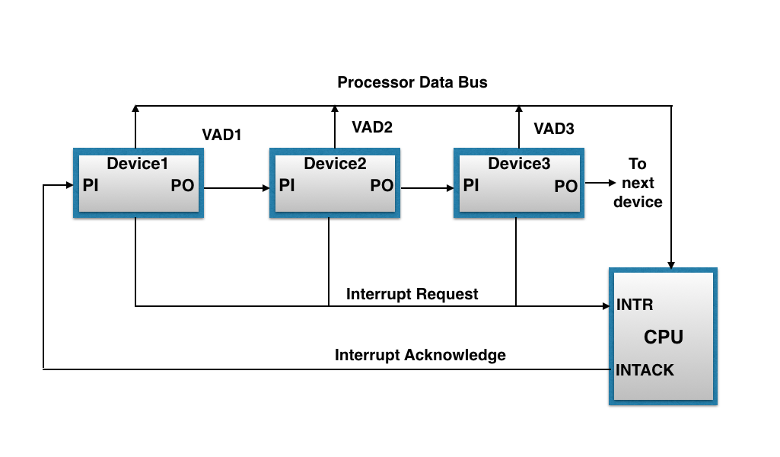
The figure shown below, this method of connection with three devices and the CPU.

Slide 23
It works as follows:
When any device raise an interrupt, the interrupt request line goes activated, the processor when sense it, it sends out an interrupt acknowledge which is first received by device1.If device1 does not need service, i.e., processor checks, whether the device has pending interrupt or initiate interrupt request, if the result is no, then the signal is passed to device2 by placing 1 in the PO(Priority Out) of device1.And if device need service then service is given to them by placing first 0 in the PO of 1 device1, which indicate the next-lower-priority device that acknowledge signal has been blocked.And device that have processor responds by inserting its own interrupt vector address(VAD) into the data bus for the CPU to use during interrupt cycle.
In this way, it gave services to interrupt source according to their priority.And thus, we can say that, it is the order of device in chain that determine the priority of interrupt sources.

Slide 24
DMA
Stands for "Direct Memory Access." DMA is a method of transferring data from the computer's RAM to another part of the computer without processing it using the CPU. While most data that is input or output from your computer is processed by the CPU, some data does not require processing, or can be processed by another device. In these situations, DMA can save processing time and is a more efficient way to move data from the computer's memory to other devices.
For example, a sound card may need to access data stored in the computer's RAM, but since it can process the data itself, it may use DMA to bypass the CPU. Video cards that support DMA can also access the system memory and process graphics without needing the CPU. Ultra DMA hard drives use DMA to transfer data faster than previous hard drives that required the data to first be run through the CPU.

Slide 25
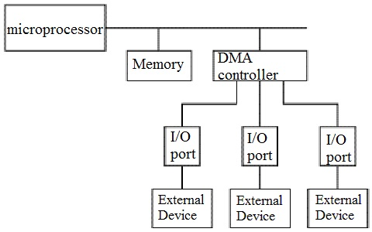

Slide 26
I/O Processor and serial communication
An input-output processor (IOP) is a processor with direct memory access capability. In this, the computer system is divided into a memory unit and number of processors.
Each IOP controls and manage the input-output tasks. The IOP is similar to CPU except that it handles only the details of I/O processing. The IOP can fetch and execute its own instructions. These IOP instructions are designed to manage I/O transfers only.

Slide 27
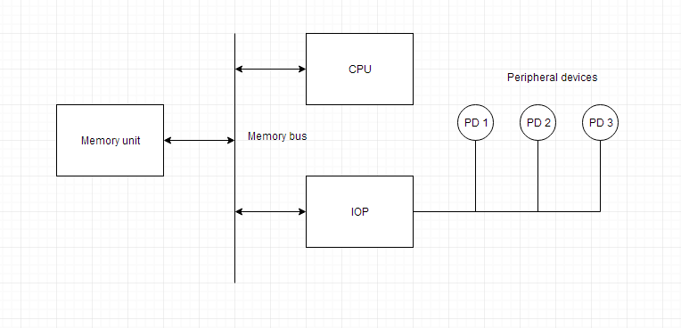
Block Diagram Of I/O Processor

Slide 28
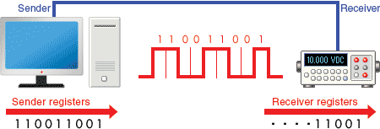
Serial Communication
Serial communication is a communication method that uses one or two transmission lines to send and receive data, and that data is continuously sent and received one bit at a time.Since it allows for connections with few signal wires, one of its merits is its ability to hold down on wiring material and relaying equipment costs.

Slide 29
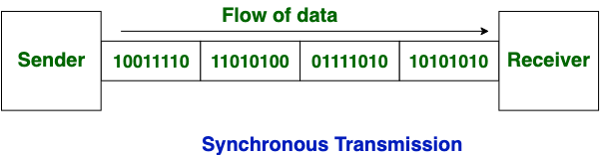
Synchronous data transfer
In Synchronous Transmission, data is sent in form of blocks or frames. This transmission is the full duplex type. Between sender and receiver the synchronization is compulsory. In Synchronous transmission, There is no gap present between data. It is more efficient and more reliable than asynchronous transmission to transfer the large amount of data.

Slide 30
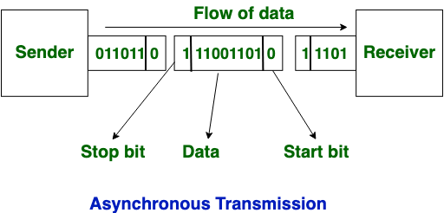
Asynchronous data transfer
This Scheme is used when speed of I/O devices do not match with microprocessor, and
timing characteristics of I/O devices is not predictable. In this method, process initiates the
device and check its status. As a result, CPU has to wait till I/O device is ready to transfer
data. When device is ready CPU issues instruction for I/O transfer. In this method two types
of techniques are used based on signals before data transfer.
i.Strobe Control
ii. Handshaking

Slide 31
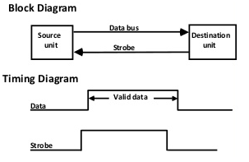
Strobe Control
The strobe control method of Asynchronous data transfer employs a single control line to
time each transfer. The strobe may be activated by either the source or the destination unit.
Data Transfer Initiated by Source Unit:
Source initiated strobe for data transfer

Slide 32
In the block diagram fig. 1 the data bus carries the binary information from source to
destination unit. Typically, the bus has multiple lines to transfer an entire byte or word. The
strobe is a single line that informs the destination unit when a valid data word is available.
The timing diagram fig. 2 the source unit first places the data on the data
bus. The information on the data bus
Data Transfer Initiated by Destination Unit:
In this method, the destination unit activates the strobe pulse, to informing the source to
provide the data. The source will respond by placing the requested binary information on the
data bus.
The data must be valid and remain in the bus long enough for the destination
unit to accept it. When accepted the destination unit then disables the strobe and the source
unit removes the data from the bus.

Slide 33
Handshaking
The handshaking method solves the problem of strobe method by introducing a second
control signal that provides a reply to the unit that initiates the transfer.
Principle of Handshaking:
The basic principle of the two-wire handshaking method of data transfer is as follow:
One control line is in the same direction as the data flows in the bus from the source to
destination. It is used by source unit to inform the destination unit whether there a valid data
in the bus. The other control line is in the other direction from the destination to the source. It
is used by the destination unit to inform the source whether it can accept the data. The
sequence of control during the transfer depends on the unit that initiates the transfer.
Source Initiated Transfer using Handshaking:
The sequence of events shows four possible states that the system can be at any given time.
The source unit initiates the transfer by placing the data on the bus and enabling its data valid
signal. The data accepted signal is activated by the destination unit after it accepts the data
from the bus. The source unit then disables its data accepted signal and the system goes into
its initial state.

Slide 34
PCI
Stands for "Peripheral Component Interconnect." PCI is a hardware bus used for adding internal components to a desktop computer. For example, a PCI card can be inserted into a PCI slot on a motherboard, providing additional I/O ports on the back of a computer.
The PCI architecture, also known as "conventional PCI," was designed by Intel and introduced in 1992. Many desktop PCs from the early 1990s to the mid 2000s had room for two to five PCI cards. Each card required an open slot on the motherboard and a removable panel on the back of the system unit. Adding PCI cards was an easy way to upgrade a computer, since you could add a better video card, faster wired or wireless networking, or add new ports, like USB 2.0.
The original 32-bit, 33 MHz PCI standard supported data transfer rates of 133 megabytes per second. An upgraded 64-bit, 66 MHz standard was created a few years later and allowed for much faster data transfer rates up to 533 MHz. In 1998, IBM, HP, and Compaq introduced PCI-X (or "PCI eXtended"), which was backwards compatible with PCI. The 133 MHz PCI-X interface supported data transfer rates up to 1064 MHz.
Both PCI and PCI-X were superseded by PCI Express, which was introduced in 2004.

Slide 35
WORKING MECHANISM OF PERIPHERALS
Working Principle of a Keyboard:-
Inside the keyboard, there are metallic
plate, circuit board and processor, which are responsible for transferring
information from the keyboard to the computer. Depending upon the
working principle, there are two main types of keys, namely, capacitive and
hard-contact. Let's discuss in brief about the functioning of capacitive and
hard contact key.When a capacitive key is pressed, the metal plunger applies
a gentle pressure to the circuit board. The pressure is identified by the
computer and the circuit flow is initiated, resulting in the transfer of
information from the circuit to the currently installed software.
The key identifying to computer is identified using a keyboard driver and
finding the preferred key called
source code.

Slide 36
WORKING MECHANISM OF MOUSE
• Working of a mouse---
> With most of the system you will find mechanical mouse.The primary mechanical part of a
mouse is a ball on the bottom of the mouse. There are these little wheels which turn/rotate
when the ball moves against them. The wheels are monitored electronically. When they trun
or rotate they transmit how much they have turned to the computer. Out of these three wheels
the two wheels perpendicular to each other are used for tracking the motion on X-axis and Y-
axis. The third one just balances the two.
When the mouse is moved on a flat surface the roller ball moves in the locking ring. When the
mouse is positioned on the desktop the actuators register the mouse balls movement in X-axis
and Y-axis direction. The sensors attached to it generate a series of pulses representing
movement on both axis. The pulse generated are in same ratio as the mouse movement i.e.

Slide 37
More pulse mean more movement.
Normally a mouse is used along with a mouse pad. Place the mouse pad on a flat surface and
place the mouse on it. Move the mouse pad and the pointer moves in the direction of the
movement of mouse.
--Various terms related to the use of mouse are :-
> Click
> Double click
> Drag
1. When the left button of mouse is pressed and released quickly then this we can say '
clicking the mouse '.
2. The double clicking is used to initiate some action on the selected item. Basically it selects

Slide 38
WORKING OF SCANNER
A scanner is a device that is used for producing an exact digital image
replica of a photo, text written in paper, or even an object. This digital
image can be saved as a file to your computer and can be used to
alter/enhance the image or apply it to the web. The most comonly
used scanner is the flatbed scanner, in which you keep the object on
top of the glass window. The scanned output will be obtained in your
computer. The image and text are obtained exactly through the
process of optical character recognition [OCR].
Handheld scanners use the same basic technology as a flatbed scanner, but rely on the user to move them
instead of a motorized belt. This type of scanner typically does not provide good image quality. However, it can
be useful for quickly capturing text.
• Drum scanners are used by the publishing industry to capture incredibly detailed images. They use a
technology called a photomultiplier tube (PMT). In PMT, the document to be scanned is mounted on a glass
cylinder. At the center of the cylinder is a sensor that splits light bounced from the document into three beams.
Each beam is sent through a color filter into a photomultiplier tube where the light is changed into an electrical
signal.
• The basic principle of a scanner is to analyze an image and process it in some way. Image and text capture
(optical character recognition or OCR) allow you to save information to a file on your computer.

Slide 39
WORKING OF VIDEO DISPLAY
Video display device means an electronic device with an output surface that
displays, or is capable of displaying, moving graphical images or a visual
representation of image sequences or pictures, showing a number of quickly
changing images on a screen in fast succession to create the illusion of motion,
including, if applicable, a device that is an integral part of the display, in that it
cannot be easily removed from the display by the consumer, that produces the
moving image on the screen. A video display device may use, but is not limited to, a
cathode ray tube (CRT), liquid crystal display (LCD), gas plasma, digital light
processing, or other image projection technology.
device means a printer or a unit capable of presenting images
electronically on a screen, with a video display greater than four inches
when measured diagonally, that are viewed by the user, and includes
televisions, computer monitors, laptop computers, cathode ray tubes,
plasma displays, liquid crystal displays, rear and front enclosed projection
devices, and other similar displays that may be developed.

Slide 40
WORKING OF TOUCH SCREEN PANNEL
Different kinds of touchscreen work in different ways. Some can sense
only one finger at a time and get extremely confused if you try to press
in two places at once. Others can easily detect and distinguish more
than one key press at once. These are some of the main
technologies:
• Resistive
• Resistive touchscreens (currently the most popular technology) work a
bit like "transparent keyboards" overlaid on top of the screen. There's
a flexible upper layer of conducting polyester plastic bondedd to a
rigid lower layer of conducting glass and separated by an insulating
membrane. When you press on the screen, you force the polyester to
touch the glass and complete a circuit—just like pressing the key on a
keyboard. A chip inside the screen figures out the coordinates of the
place you touched.

Slide 41
Capacitive
• These screens are made from multiple layers of glass. The inner layer
conducts electricity and so does the outer layer, so effectively the screen
behaves like two electrical conductors separated by an insulator—in other
words, a capacitor.When you bring your finger up to the screen, you alter the
electrical field by a certain amount that varies according to where your hand
is. Capacitive screens can be touched in more than one place at once.
Unlike most other types of touchscreen, they don't work if you touch them
with a plastic stylus (because the plastic is an insulator and stops your hand
from affecting the electric field).
Infrared
• Just like the magic eye beams in an intruder alarm, an infrared touchscreen
uses a grid pattern of LEDs and light-detector photocells arranged on
opposite sides of the screen. The LEDs shine infrared light in front of the
screen—a bit like an invisible spider's web. If you touch the screen at a
certain point, you interrupt two or more beams. A microchip inside the screen
can calculate where you touched by seeing which beams you interrupted.
The touchscreen on Sony Reader ebooks (like the one pictured in our top
photo) works this way. Since you're interrupting a beam, infrared screens
work just as well whether you use your finger or a stylus

Slide 42
Surface Acoustic Wave
• Surprisingly, this touchscreen technology detects your fingers using
• Sound instead of light. Ultrasonic sound waves (too high pitched for
humans to hear) are generated at the edges of the screen and reflected
back and forth across its surface. When you touch the screen, you interrupt
the sound beams and absorb some of their energy. The screen's microchip
controller figures out from this where exactly you touched the screen.

Slide 43
UNIT-3

Slide 44
STACK ORGANIZATION
A useful feature that is included in the CPU of most computers is a stack or last-in, first-out (LIFO) list. A stack is a storage device that stores information in such a manner that the item stored last is the first item retrieved. The operation of a stack can be compared to a stack of trays. The last tray placed on top of the stack is the first to be taken off. The stack in digital computers is essentially a memory unit with an address register that can count only (after an initial value is loaded into it). The register that holds the address for the stack is called a stack pointer (SP) because its value always points at the top item in the stack. Contrary to a stack of trays where the tray itself may be taken out or inserted, the physical registers of a stack are always available for reading or writing. It is the content of the word that is inserted or deleted.
The two operations of a stack are the insertion and deletion of items. The operation of insertion is called push (or push-down) because it can be through of as the result of pushing a new item on top. The operation of deletion is called pop (or pop-up) because it can be thought of as the result of removing one item so hat the stack pops up. However, nothing is pushed or popped in a computer stack. these operation are simulated by incrementing or decrementing the stack pointer register.

Slide 45
INSTRUCTION FORMATS
A computer will usually have a variety of instruction code formats. It is the function of the control unit within the CPU to interpret each instruction code and provide the necessary control functions needed to process the instruction.

Slide 46
The format of an instruction is usually depicted in a rectangular box symbolizing the bits of the instruction as they appear in memory words or in a control register. The bits of the instruction are divided into groups called fields. The most common fields found in instruction formats are:
1. An operation code field that specifies the operation to be performed.
2. An address field that designates a memory address or a processor register.
3. A mode field that specifies the way the operand or the effective address is determined.

Slide 47
THREE-ADDRESS INSTRUCTIONS
Computers with three-address instruction formats can use each address field to specify either a processor register or a memory operand. The program in assembly language that evaluates X =(A + B) ∗ (C + D) is shown below, together with comments that explain the register transfer operation of each instruction.
ADD R1, A, B R1 ← M [A] + M [B]
ADD R2, C, D R2 ← M [C] + M [D]
MUL X, R1, R2 M [X] ← R1 ∗ R2
It is assumed that the computer has two processor registers, R1 and R2. The symbol M [A] denotes the operand at memory address symbolized by A.

Slide 48
TWO-ADDRESS INSTRUCTIONS
Two address instructions are the most common in commercial computers. Here again each address field can specify either a processor register or a memory word. The program to evaluate X = (A + B) ∗ (C + D) is as follows:
MOV R1, A R1 ← M [A]
ADD R1, B R1 ← R1 + M [B]
MOV R2, C R2 ← M [C]
ADD R2, D R2 ← R2 + M [D]
MUL R1, R2 R1 ← R1 ∗ R2
MOV X, R1 M [X] ← R1
The MOV instruction moves or transfers the operands to and from memory and processor registers. The first symbol listed in an instruction is assumed to be both a source and the destination where the result of the operation is transferred.

Slide 49
ONE-ADDRESS INSTRUCTIONS
One-address instructions use an implied accumulator (AC) register for all data manipulation. For multiplication and division there is a need for a second register. However, here we will neglect the second and assume that the AC contains the result of tall operations. The program to evaluate X = (A + B) ∗ (C + D) is
LOAD A AC ← M [A]
ADD B AC ← A [C] + M [B]
STORE T M [T] ← AC
LOAD C AC ← M [C]
ADD D AC ← AC + M [D]
MUL T AC ← AC ∗ M [T]
STORE X M [X] ← AC
All operation are done between the AC register and a memory operand. T is the address of a temporary memory location required for storing the intermediate result.

Slide 50
ZERO-ADDRESS INSTRUCTIONS
A stack-organized computer does not use an address field for the instructions ADD and MUL.
The PUSH and POP instructions, however, need an address field to specify the operand that
communicates with the stack. The following program shows how X = (A + B) ∗ (C + D) will be
written for a stack organized computer. (TOS stands for top of stack)
PUSH A TOS ← A
PUSH B TOS ← B
ADD TOS ← (A + B)
PUSH C TOS ← C
PUSH D TOS ← D
ADD TOS ← (C + D)
MUL TOS ← (C + D) ∗ (A + B)
POP X M [X] ← TOS
To evaluate arithmetic expressions in a stack computer, it is necessary to convert the expression into reverse Polish notation. The name “zero-address” is given to this type of computer because of the absence of an address field in the computational instructions

Slide 51
ADDRESSING MODES
The operation field of an instruction specifies the operation to be performed. This operation must
be executed on some data stored in computer registers or memory words. The way the operands
are chosen during program execution in dependent on the addressing mode of the instruction.

Slide 52
To understand the various addressing modes to be presented in this section, it is imperative that we understand the basic operation cycle of the computer. The control unit of a computer is designed to go through an instruction cycle that is divided into three major phases:
1. Fetch the instruction from memory
2. Decode the instruction.
3. Execute the instruction.

Slide 53
Immediate Mode : In this mode the operand is specified in the instruction itself. In
other words, an immediate-mode instruction has an operand field rather than an address field.
The operand field contains the actual operand to be used in conjunction with the operation
specified in the instruction. Immediate-mode instructions are useful for initializing registers to a
constant value.
It was mentioned previously that the address field of an instruction may specify either a memory word or a processor register. When the address field specifies a processor register, the
instruction is said to be in the register mode.
Register Mode : In this mode the operands are in registers that reside within the CPU.
The particular register is selected from a register field in the instruction. A k-bit field can specify
any one of 2k registers.
Register Indirect Mode : In this mode the instruction specifies a register in the CPU
whose contents give the address of the operand in memory. In other words, the selected register
contains the address of the operand rather than the operand itself. Before using a register indirect
mode instruction, the programmer must ensure that the memory address fo the operand is placed
in the processor register with a previous instruction. A reference to the register is then equivalent
to specifying a memory address. The advantage of a register indirect mode instruction is that the
address field of the instruction sues fewer bits to select a register than would have been required
to specify a memory address directly.

Slide 54
Direct Address Mode: In this mode the effective address is equal to the address part of the instruction. The operand resides in memory and its address is given directly by the address field of the instruction. In a branch-type instruction the address field specifies the actual branch address.
Indirect Address Mode: In this mode the address field of the instruction gives the address where the effective address is stored in memory. Control fetches the instruction from memory and uses its address part to access memory again to read the effective address.

Slide 55
Indexed Addressing Mode:
In this mode the content of an index register is added to the address part of the instruction to obtain the effective address. The index register is a special CPU register that contains an index value. The address field of the instruction defines the beginning address of a data array in memory. Each operand in the array is stored in memory relative to the beginning address. The distance between the beginning address and the address of the operand is the index value stores in the index register. Any operand in the array can be accessed with the same instruction provided that the index register contains the correct index value. The index register can be incremented to facilitate access to consecutive operands. Note that if an index type instruction does not include an address field in its format, the instruction converts to the register indirect mode of operation.
Some computers dedicate one CPU register to function solely as an index register. This register is involved implicitly when the index-mode instruction is used. In computers with many processor registers, any one of the CPU registers can contain the index number. In such a case the register must be specified explicitly in a register field within the instruction format.

Slide 56
Relative Address Mode:
In this mode the content of the program counter is added to the
address part of the instruction in order to obtain the effective address. The address part of the
instruction is usually a signed number (in 2’s complement representation) which can be either
positive or negative. When this number is added to the content of the program counter, the result produces an effective address whose position in memory is relative to the address of the next instruction. To clarify with an example, assume that the program counter contains the number 825 and the address part of the instruction contains the number 24. The instruction at location 825 is read from memory during the fetch phase and the program counter is then incremented by one to 826 + 24 = 850. This is 24 memory locations forward from the address of the next instruction. Relative addressing is often used with branch-type instructions when the branch address is in the area surrounding the instruction word itself. It results in a shorter address field in the instruction format since the relative address can be specified with a smaller number of bits compared to the number of bits required to designate the entire memory address.

Slide 57
Base Register Addressing Mode:
In this mode the content of a base register is added to the address part of the instruction to obtain the effective address. This is similar to the indexed addressing mode except that the register is now called a base register instead of an index register. The difference between the two modes is in the way they are used rather than in the way that they are computed. An index register is assumed to hold an index number that is relative to the address part of the instruction. A base register is assumed to hold a base address and the address field of the instruction gives a displacement relative to this base address. The base register addressing mode is used in computers to facilitate the relocation of programs in memory. When programs and data are moved from one segment of memory to another, as required in multiprogramming systems, the address values of the base register requires updating to reflect the beginning of a new memory segment.

Slide 58
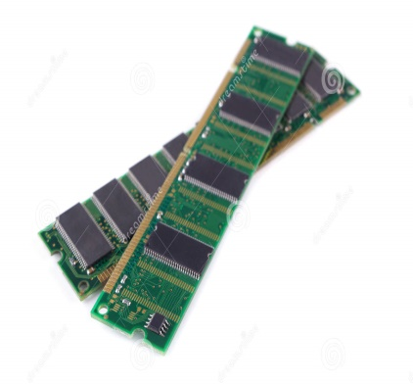
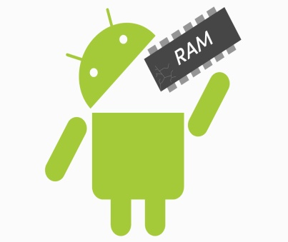
UNIT - 4

Slide 59
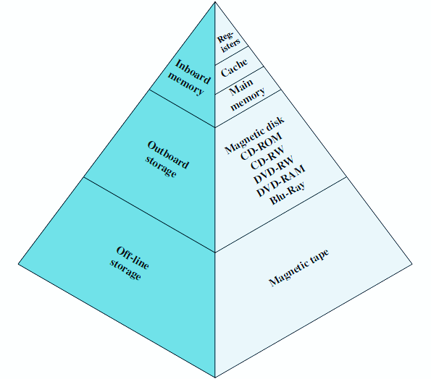
the MEMORY HIERARCHY
The memory in a computer can be divided into five hierarchies based on the speed as well as use. The processor can move from one level to another based on its requirements:-
PRIMARY MEMORY:-
It is also called as internal memory. It includes main memory, cache & registers.
SECONDARY MEMORY:-
It is also called external memory and this is accessible by the processor through an input/output module. This memory includes an optical disk, magnetic disk, and magnetic tape.

Slide 60
Characteristics of memory hierarchy
PERFORMANCE:-
Previously, the designing of a computer system was done without memory hierarchy, and the speed gap among the main memory as well as the CPU registers enhances because of the huge disparity in access time, which will cause the lower performance of the system. So, the enhancement was mandatory. The enhancement of this was designed in the memory hierarchy model due to the system’s performance increase.
Ability:-
The ability of the memory hierarchy is the total amount of data the memory can store. Because whenever we shift from top to bottom inside the memory hierarchy, then the capacity will increase.
ACCESS TIME:-
The access time in the memory hierarchy is the interval of the time among the data availability as well as request to read or write. Because whenever we shift from top to bottom inside the memory hierarchy, then the access time will increase

Slide 61
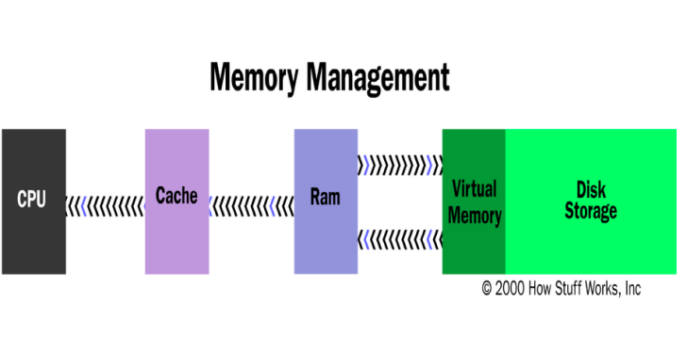
COST PER BIT:-
When we shift from bottom to top inside the memory hierarchy, then the cost for each bit will increase which means an internal Memory is expensive compared with external memory.
THE MEMORY HIERARCHY DESIGN:-
It consists of:-
REGISTERS:-Usually, the register is a static RAM or SRAM in the processor of the computer which is used for holding the data word which is typically 64 or 128 bits. The program counter register is the most important as well as found in all the processors. Most of the processors use a status word register as well as an accumulator.
CACHE MEMORY:-Cache memory can also be found in the processor, however rarely it may be another IC (integrated circuit) which is separated into levels. The cache holds the chunk of data which are frequently used from main memory.

Slide 62
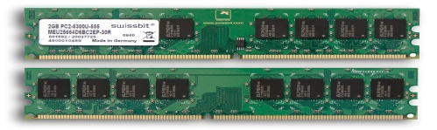
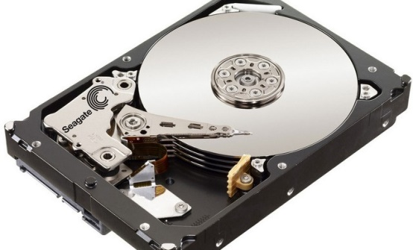
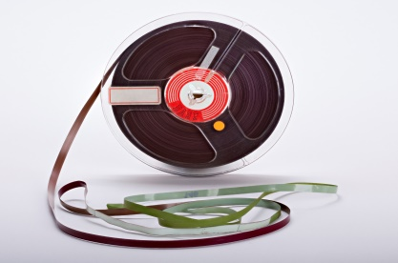
MAIN MEMORY:-The main memory in the computer is nothing but, the memory unit in the CPU that communicates directly. It is the main storage unit of the computer. This memory is fast as well as large memory used for storing the data throughout the operations of the computer. This memory is made up of RAM as well as ROM.
MAGNETIC DISKS:-The magnetic disks in the computer are circular plates fabricated of plastic otherwise metal by magnetized material. All the disks in computer turn jointly at high speed. The tracks in the computer are nothing but bits which are stored within the magnetized plane in spots next to concentric circles. These are usually separated into sections which are named as sectors.
MAGNETIC TAPE:-This tape is a normal magnetic recording which is designed with a slender magnetizable covering on an extended, plastic film of the thin strip. This is mainly used to back up huge data. The access time of memory will be slower within magnetic strip as well as it will take a few minutes for accessing a strip.

Slide 63
Advantages of Memory Hierarchy
The need for a memory hierarchy includes the following.
Memory distributing is simple and economical.
Removes external destruction.
Data can be spread all over.
Permits demand paging & pre-paging.
Swapping will be more proficient.

Slide 64
MEMORY
Internal
Memory
External
Memory
Cache
Registers
Hard Disk
Optical Disk
RAM
ROM
Magnetic DIsk
Static RAM
Dynamic RAM
PROM
EPROM
EDO
SD
EEPROM

Slide 65
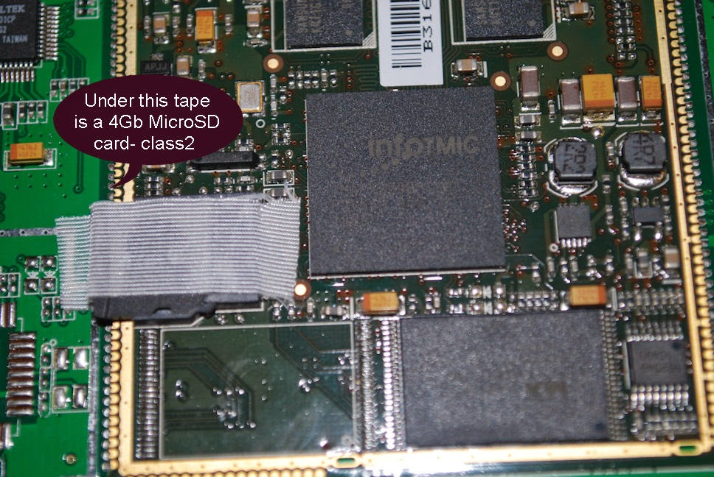
Internal Memory
In computer, all of the storage spaces that are accessible by a processor without the use of computer input/output channels.
Internal Memory usually includes several types of storage such as main storage, cache storage, cache memory and special registers, all of which can be directly accessed by the processor.
It typically refers to the main memory(RAM) but may also refer to ROM and Flash Memory. In either case, internal memory generally refers to chips rather than disks or tapes.
It often refers to simply as memory, is the only one directly accessible to the CPU.

Slide 66
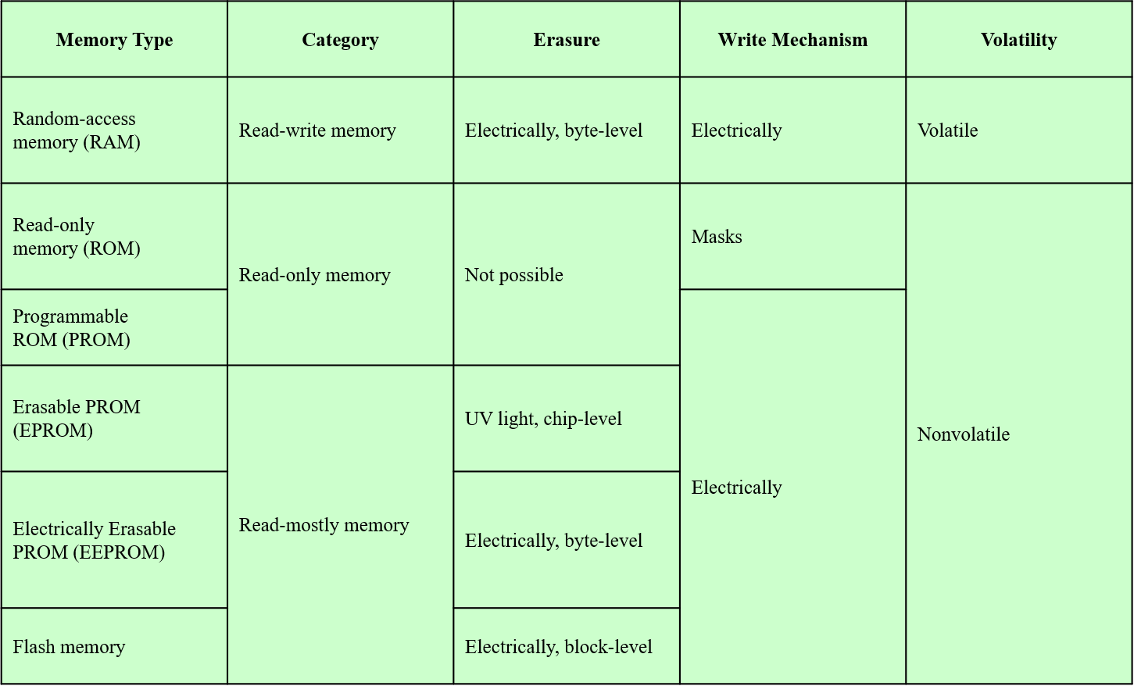
Secondary memory types

Slide 67
RAM(RANDOM ACCESS MEMORY)
Misnamed as all semiconductor memory is random access
Read/Write
Volatile
Temporary storage
Static or dynamic

Slide 68
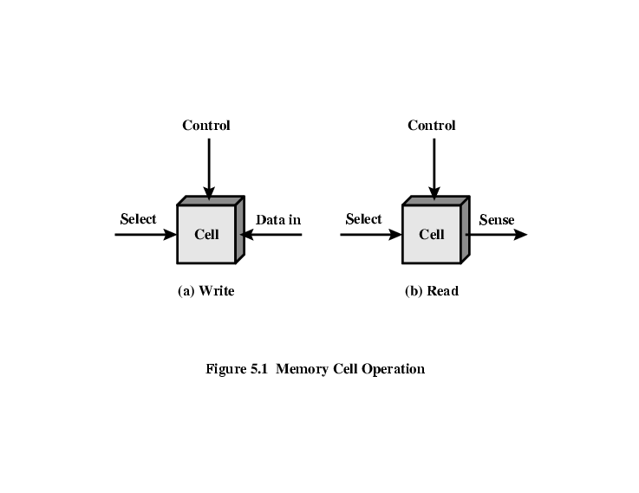
Memory cell operation

Slide 69
Dynamic RAM
Bits stored as charge in capacitors
Charges leak.
Need refreshing even when powered
Simpler construction
Smaller per bit
Less expensive
Need refresh circuits
Slower
Main memory
Essentially analogue
Level of charge determines value

Slide 70
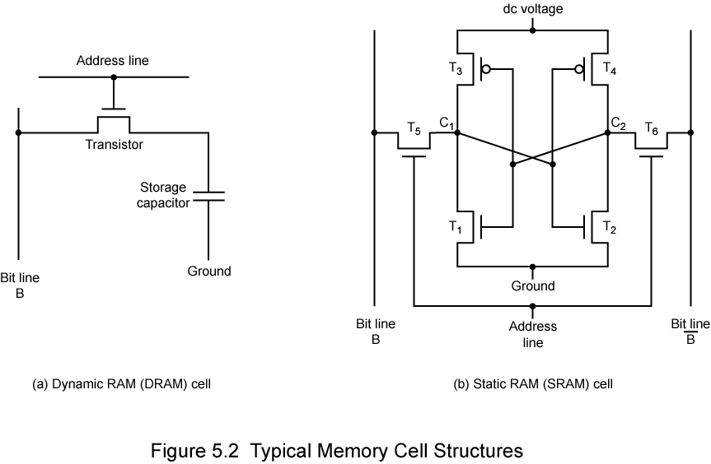
Structure of Dynamic RAM

Slide 71
STATIC RAM
Bits stored as on/off switches
No charges to leak
No refreshing needed when powered
More complex construction
Larger per bit
More expensive
Does not need refresh circuits
Faster
Cache
Digital
Uses flip-flops

Slide 72
Structure of Static RAM

Slide 73
Difference between SRAM & DRAM
SRAM
Faster.
Expensive.
Small.
Single memory block requires six transistor.
Low power consumption.
Therefore static RAM is used to create the CPU's speed-sensitive cache.
DRAM
Slower.
Cheaper.
Large.
Single memory block requires only one transistors.
High power consumption.
Dynamic RAM forms the larger system RAM space.

Slide 74
Synchronous DRAM(SDRAM)
Access is synchronized with an external clock.
Address is presented to RAM.
RAM finds data (CPU waits in conventional DRAM)
Since SDRAM moves data in time with system clock, CPU knows when data will be ready
CPU does not have to wait, it can do something else
Burst mode allows SDRAM to set up stream of data and fire it out in block
DDR-SDRAM sends data twice per clock cycle (leading & trailing edge)

Slide 75
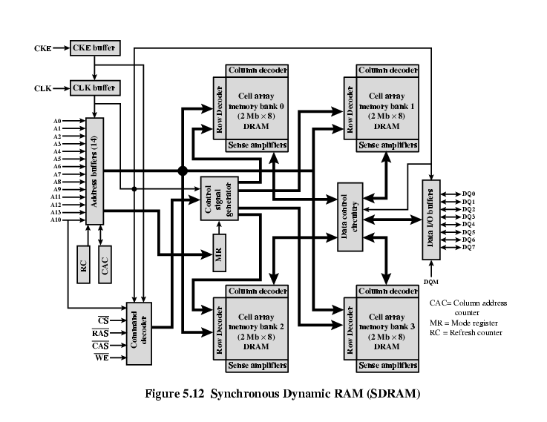
Structure of SDRAM

Slide 76
RAMBUS
Adopted by Intel for Pentium & Itanium
Main competitor to SDRAM
Vertical package – all pins on one side
Data exchange over 28 wires < cm long
Bus addresses up to 320 RDRAM chips at 1.6Gbps
Asynchronous block protocol
480ns access time
Then 1.6 Gbps

Slide 77
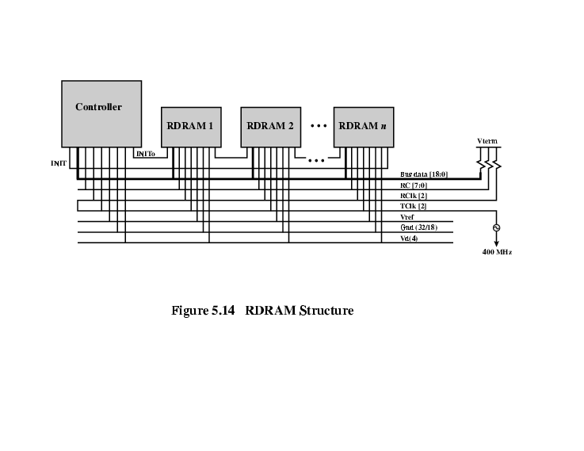
Structure of RAMBUS

Slide 78
ROM(READ ONLY MEMORY)
Permanent storage.
Nonvolatile.
Retain data even without electricity flow i.e. power off.
Pre-written(holds code for booting-up the computer).
Systems programs (BIOS).
Data in unchangeable in this.

Slide 79
Types of ROM
ROM.
PROM.
EPROM.
EEPROM.
Flash memory.

Slide 80
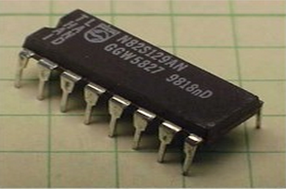
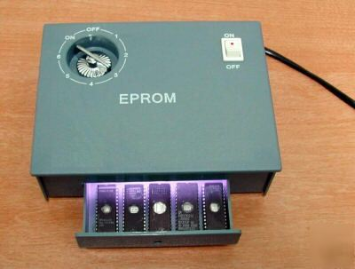
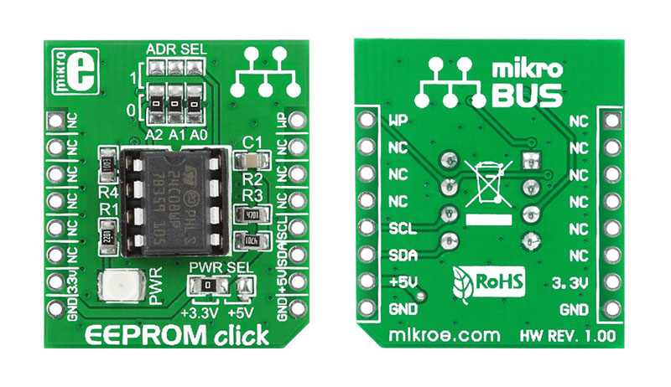
PROM : Short for programmable read-only memory, a memory chip on which data can be written only once. Once a program has been written onto a PROM, it remains there forever. Unlike RAM, PROMs retain their contents when the computer is turned off. The difference between a PROM and a ROM (read-only memory) is that a PROM is manufactured as blank memory, whereas a ROM is programmed during the manufacturing process. To write data onto a PROM chip, you need a special device called a PROM programmer or PROM burner. The process of programming a PROM is sometimes called burning the PROM.
EPROM : Acronym for erasable programmable read-only memory, and pronounced ee-prom, EPROM is a special type of memory that retains its contents until it is exposed to ultraviolet light. The ultraviolet light clears its contents, making it possible to reprogram the memory. To write to and erase an EPROM, you need a special device called a PROM programmer or PROM burner.
EEPROM : Short form of electrically erasable programmable read-only memory. EEPROM is a special type of PROM that can be erased by exposing it to an electrical charge. Like other types of PROM, EEPROM retains its contents even when the power is turned off. Also like other types of ROM, EEPROM is not as fast as RAM.

Slide 81
External Memory
An external storage device, also referred to as auxiliary storage and secondary storage, is a device that contains all the addressable data storage that is not inside a computer's main storage or memory. An external storage device can be removable or non-removable, temporary or permanent, and accessible over a wired or wireless network.
Magnetic Disk
RAID
Removable
Optical
CD-ROM
CD-Recordable (CD-R)
CD-R/W
DVD
Magnetic Tape
TYPES

Slide 82
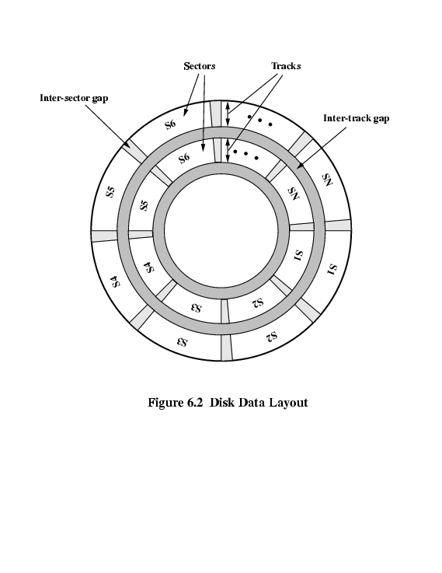
MAGNETIC DISK:-A magnetic disk is a storage device that uses a magnetization process to write, rewrite and access data. It is covered with a magnetic coating and stores data in the form of tracks, spots and sectors. Hard disks, zip disks and floppy disks are common examples of magnetic disks.
-The Disk substrate coated with magnetizable material (iron oxide…rust).
-Before, the Substrate used to be aluminium but now its glass.
-The surface uniformity is improved which increases reliability.
-Reduction in surface defects(Reduced read/write errors).
-Lower flight heights (See later)

Slide 83
RAID
Redundant Array of Independent Disks
Redundant Array of Inexpensive Disks
6 levels in common use
Not a hierarchy
Set of physical disks viewed as single logical drive by O/S
Data distributed across physical drives
Can use redundant capacity to store parity information

Slide 84
RAID 0
No redundancy
Data striped across all disks
Round Robin striping
Increase speed
Multiple data requests probably not on same disk
Disks seek in parallel
A set of data is likely to be striped across multiple disks

Slide 85
RAID 1
Mirrored Disks
Data is striped across disks
2 copies of each stripe on separate disks
Read from either
Write to both
Recovery is simple
Swap faulty disk & re-mirror
No down time
Expensive

Slide 86
RAID 2
Disks are synchronized
Very small stripes
Often single byte/word
Error correction calculated across corresponding bits on disks
Multiple parity disks store Hamming code error correction in corresponding positions
Lots of redundancy
Expensive
Not used

Slide 87
RAID 3
Similar to RAID 2
Only one redundant disk, no matter how large the array
Simple parity bit for each set of corresponding bits
Data on failed drive can be reconstructed from surviving data and parity info
Very high transfer rates

Slide 88
RAID 4
Each disk operates independently
Good for high I/O request rate
Large stripes
Bit by bit parity calculated across stripes on each disk
Parity stored on parity disk

Slide 89
RAID 5
Like RAID 4
Parity striped across all disks
Round robin allocation for parity stripe
Avoids RAID 4 bottleneck at parity disk
Commonly used in network servers
N.B. DOES NOT MEAN 5 DISKS!!!!!

Slide 90
RAID 6
Two parity calculations
Stored in separate blocks on different disks
User requirement of N disks needs N+2
High data availability
Three disks need to fail for data loss
Significant write penalty

Slide 91
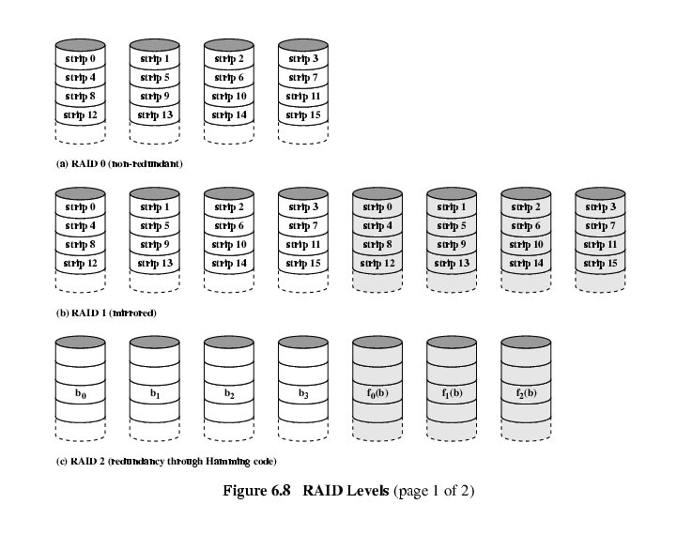
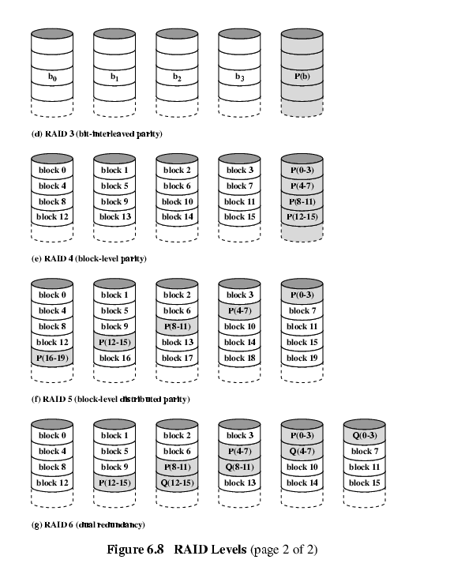
RAID 3 & 4
RAID 1 & 2
RAID 5 & 6

Slide 92
Optical CD-ROM
It is originally for audio
650Mbytes giving over 70 minutes audio
It is Polycarbonate coated with highly reflective coat, usually aluminium.
Data stored as pits.
Read by reflecting laser.
Constant packing density.
Constant linear velocity.

Slide 93
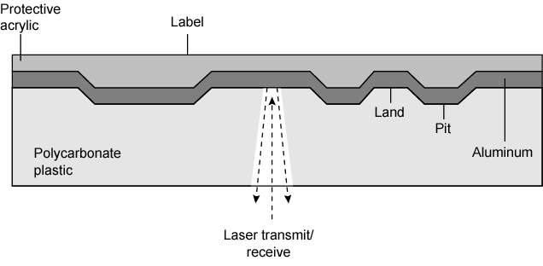
Structure Optical CD-ROM

Slide 94
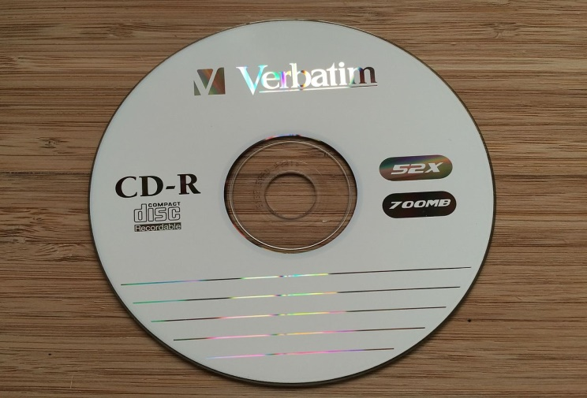
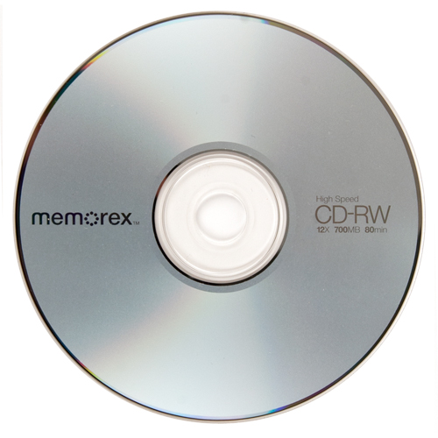
CD-Recordable (CD-R)
WORM.
Now affordable.
Compatible with CD-ROM drives.
CD-RW
Erasable.
Getting cheaper.
Mostly CD-ROM drive is compatible.
Phase change.
Material has two different reflectivities in different phase states.

Slide 95

DVD
A DVD is a type of optical media used for storing digital data. It is the same size as a CD, but has a larger storage capacity. Some DVDs are formatted specifically for video playback, while others may contain different types of data, such as software programs and computer files.
Digital Video Disk
Used to indicate a player for movies
Only plays video disks
Digital Versatile Disk
Used to indicate a computer drive
Will read computer disks and play video disks
PROPERTIES:-
It is Multi-layer
Very high capacity (4.7G per layer)
Full length movie on single disk.
Using MPEG compression.
Finally standardized.
Movies carry regional coding.
Players only play correct region films.
Can be “fixed”.

Slide 96
High definition Optical Disk
Designed for high definition videos
Much higher capacity than DVD
Shorter wavelength laser
Blue-violet range
Smaller pits
HD-DVD
15GB single side single layer
Blue-ray
Data layer closer to laser
Tighter focus, less distortion, smaller pits
25GB on single layer
Available read only (BD-ROM), Recordable once (BR-R) and re-recordable (BR-RE)

Slide 97

Magnetic Tape
It provides Serial access.
It is Slow.
Very cheap.
Backup and archive.
Linear Tape-Open (LTO) Tape Drives
Developed late 1990s.
Open source alternative to proprietary tape systems.

Slide 98
Cache Memory
It is very special high speed memory. It is used to speed up and synchronizing with high speed CPU.
Cache memory is costlier than main memory or disk memory but economical than CPU registers.
Cache memory is an extremely fast memory type that acts as a buffer between RAM and the CPU.
It holds frequently requested data and instruction so that they are immediately available to the CPU when needed.
Location
Capacity
Unit of transfer
Access method
Characteristics
Performance
Physical type
Physical characteristics
Organisation

Slide 99
LOCATION:-
CPU
Internal
External
ACCESS METHOD:-
Sequential
eg:-Tape
Direct
eg:-Disk
Random
eg:-RAM
Associative
eg:-CACHE
CAPACITY:-
Word size
The natural unit of organisation.
Number of words(or bytes).
UNIT OF TRANSFER:-
Internal
Usually governed by data bus width
External
Usually a block which is much larger than a word
Addressable unit
Smallest location which can be uniquely addressed

Slide 100
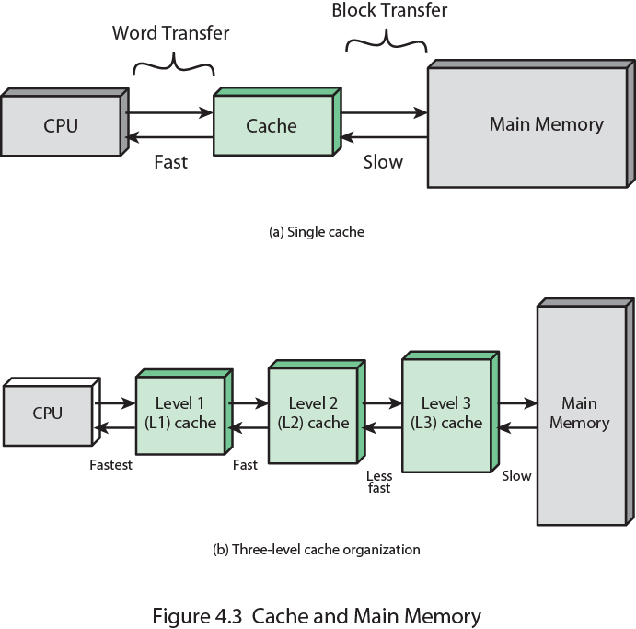
Cache and Memory

Slide 101
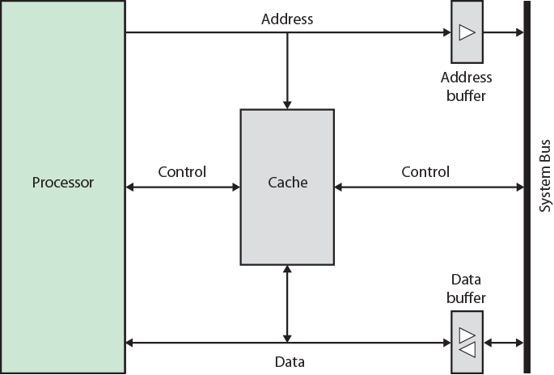
Cache organization

Slide 102
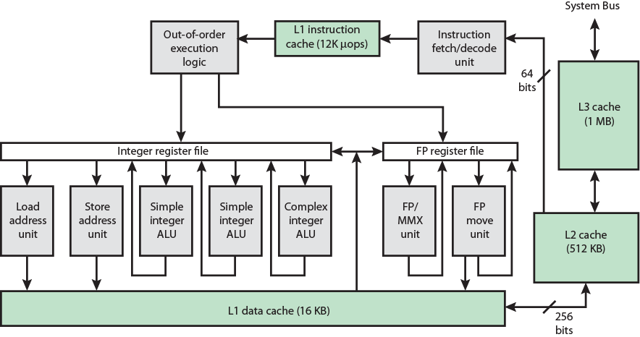
Pentium-4 Cache
80386 – no on chip cache
80486 – 8k using 16 byte lines and four way set associative organization.
Pentium (all versions) – two on chip L1 caches
Data & instructions
Pentium III – L3 cache added off chip
Pentium 4
L1 caches
8k bytes
64 byte lines
four way set associative
L2 cache
Feeding both L1 caches
256k
128 byte lines
8 way set associative
L3 cache on chip

Slide 103
ARM Cache
Small FIFO write buffer
Enhances memory write performance
Between cache and main memory
Small c.f. cache
Data put in write buffer at processor clock speed
Processor continues execution
External write in parallel until empty
If buffer full, processor stalls
Data in write buffer not available until written
So keep buffer small

Slide 104
UNIT-5

Slide 105
Fetch and Execution Cycle
The fetch execute cycle is the basic operation (instruction) cycle of a computer (also known as the fetch decode execute cycle).
During the fetch execute cycle, the computer retrieves a program instruction from its memory. It then establishes and carries out the actions that are required for that instruction.
The cycle of fetching, decoding and executing an instruction is continuously repeated by the CPU while the computer is turned on.

Slide 106
Fetching and Executing steps :
The PC contains the address of the memory location that has the next instruction which has to be fetched.
This address is then copied from the PC to the MAR via the address bus.
The contents (instruction) at the memory location (address) contained in MAR are then copied into the MDR.
The contents (instruction) in the MDR is then copied and placed into the CIR.
The value in the PC is then incremented by 1 so that it now points to the next instruction which has to be fetched.
The instruction is finally decoded and then executed by sending out signals (via control bus) to the various components of the computer.
Repeat.

Slide 107
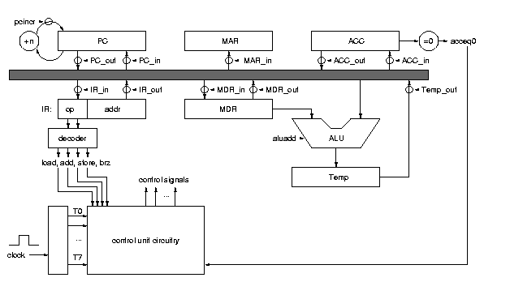
Process of execution of data/program

Slide 108
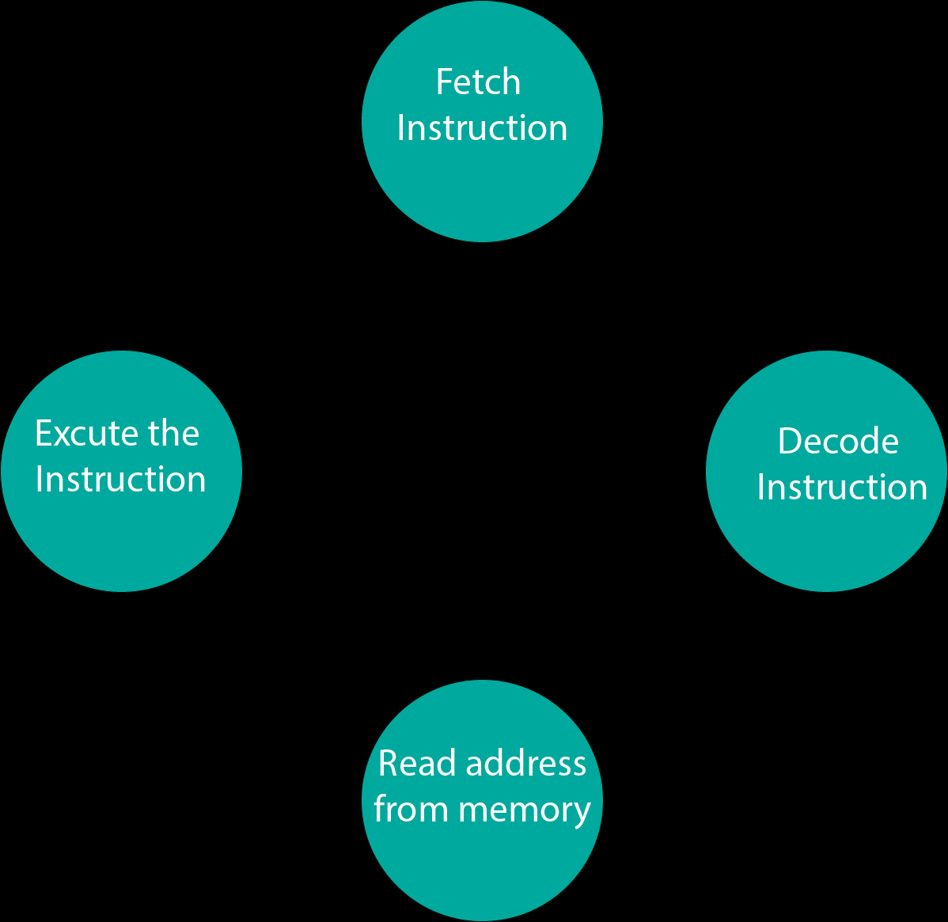
Fetch and Execution Cycle

Slide 109
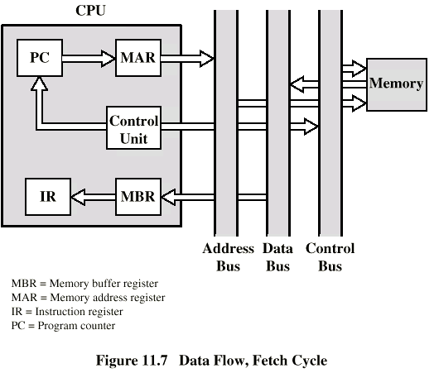
Data Flow in Fetch Cycle

Slide 110
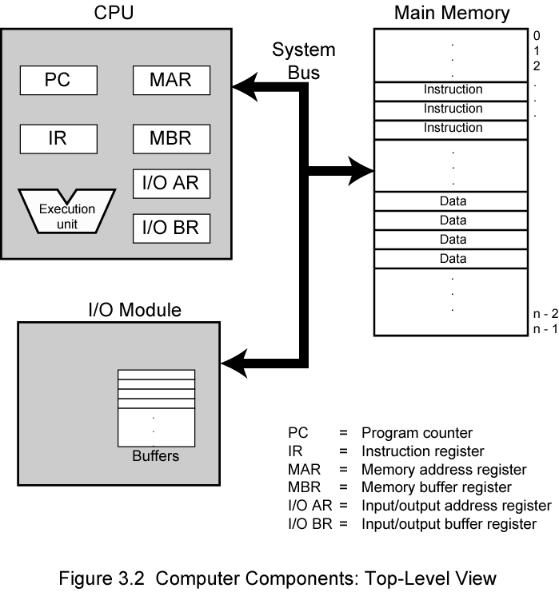
CONTROL REGISTERS
A control register is a processor register which changes or controls the general behavior of a CPU or other digital device. Common tasks performed by control registers include interrupt control, switching the addressing mode, paging control, and coprocessor control .

Slide 111
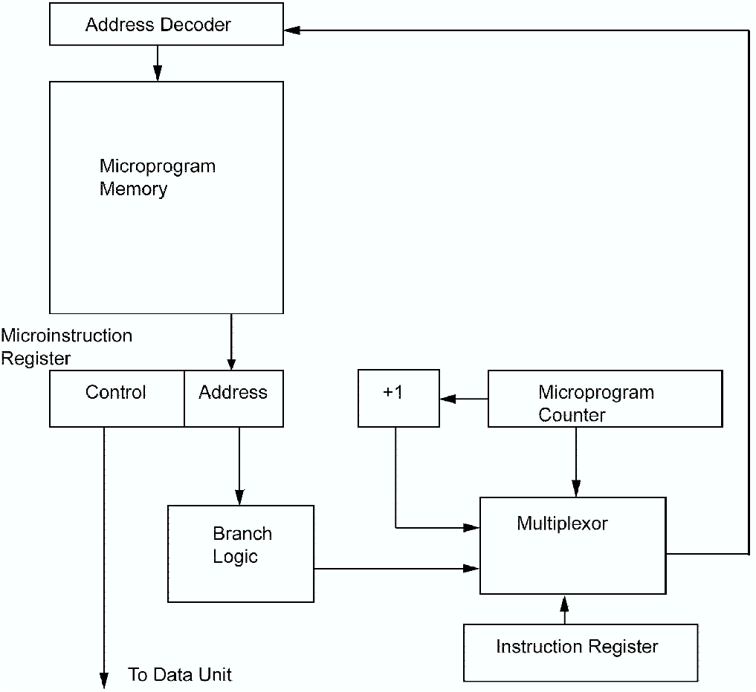
MICROPROGRAMMING
Microprogramming, Process of writing microcode for a microprocessor. Microcode is low-level code that defines how a microprocessor should function when it executes machine-language instructions. Typically, one machine-language instruction translates into several microcode instructions. On some computers, the microcode is stored in ROM and cannot be modified; on some larger computers, it is stored in EPROM and therefore can be replaced with newer versions

Slide 112

By
- NIRVAN BOBDE

